Slide 1
Module 1
Project management
Part 3

Slide 2
Content management plan
Basic and supporting plans
Requirements anagement plan
Basic schedule
Schedule management plan
Project management plan
Basic cost execution plan
Cost management plan
Quality management plan
Basic content plan
Process improvement plan
Human resources management plan
Communication management plan
Risk management plan
Procurement management plan
Stakeholder management plan

Slide 3
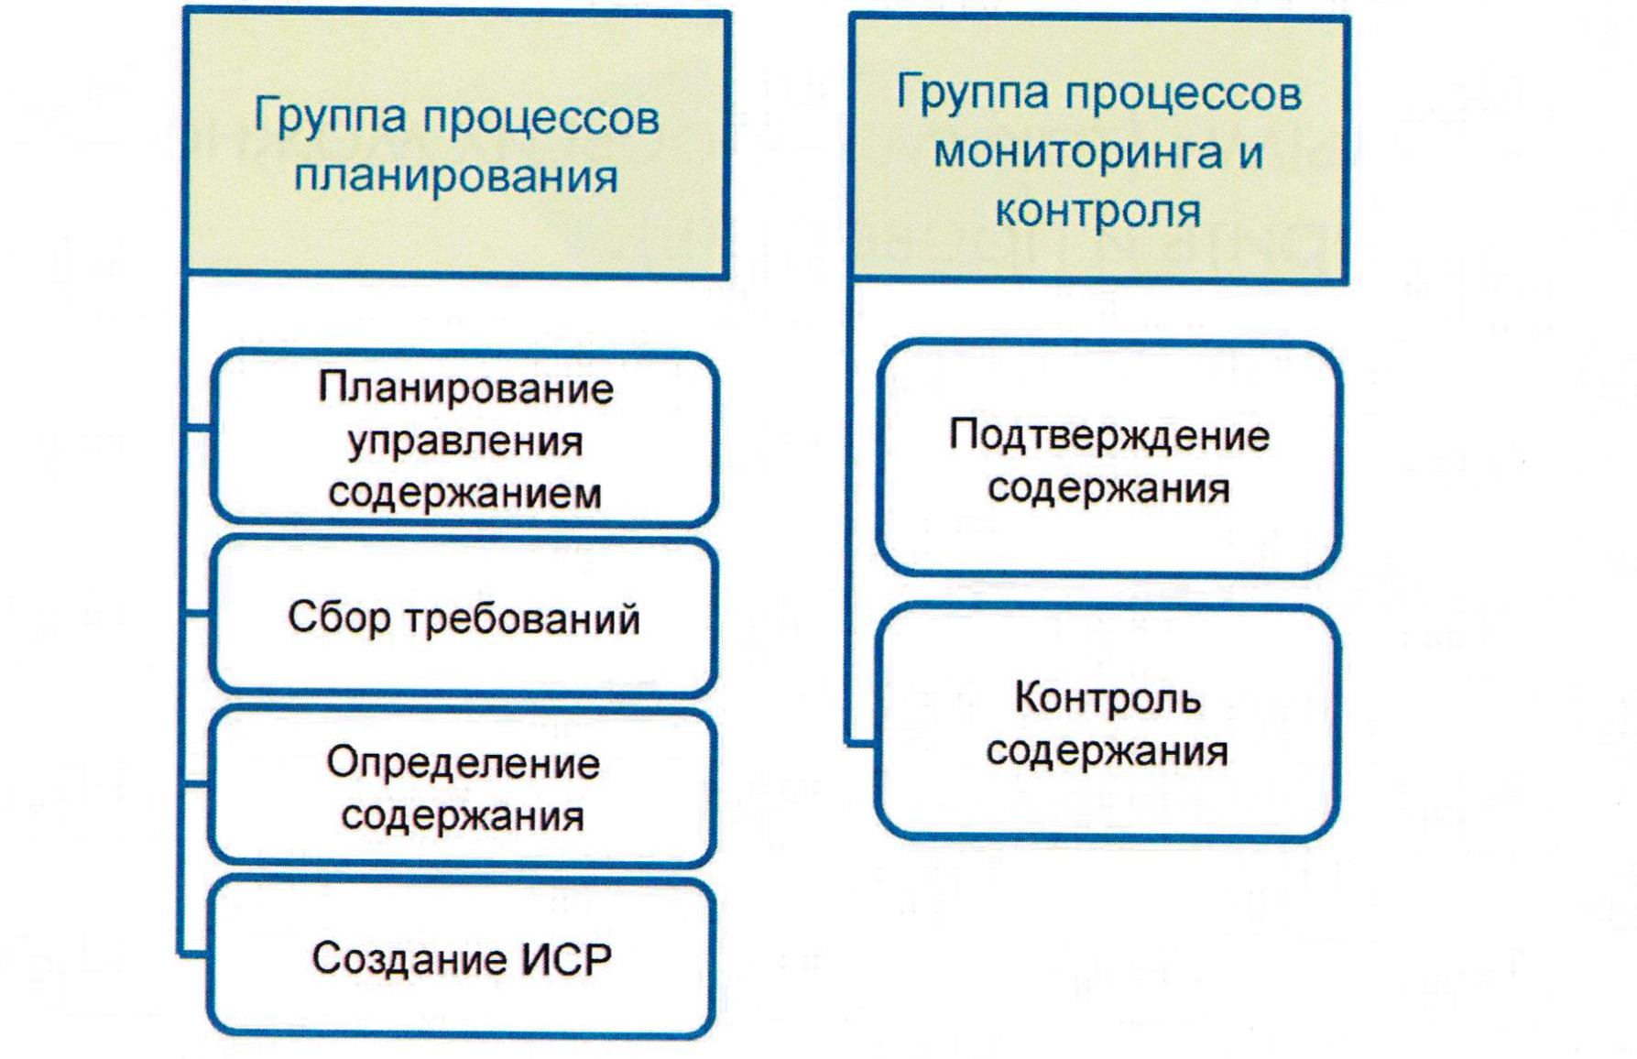
Project content management

Slide 4
Collection requirements
Collection requirements - is the process of defining and documenting the needs of project stakeholders to achieve project objectives.
Requirements - quantified and documented needs and expectations of project stakeholders.
Project requirements:
business requirements;
requirements for UE.
Product Requirements:
Technical;
Security requirements;
Performance.

Slide 5

Requirements should be:
Unambiguous
Measurable and verifiable
Tracked
Full
Serial
Acceptable for key interested parties

Slide 6
Group creative methods
Brainstorm
Delphi method
Mind mapping
Affinity diagram
Nominal group method

Slide 7

So what, what is TK. it's obvious that you had to do something wrong.

Slide 8
The content of the product - the properties and functions that characterize the product, service or result.
The content of the project - the work that must be done to obtain a product, service or result with the specified characteristics and functions.

Slide 9

Create WBS
Create WBS – separation of project results and project work into smaller elements that are easier to manage.
Work Breakdown Structure, WBS – this is a hierarchical division of the total amount of work that the project team must perform to achieve the objectives of the project and create the required results.

Slide 10
General view of ISR
The project as a whole
Phase 1
Work package 1.1
Phase 2
Work package 1.2
Work package 2.2
Work package 2.1
Work 1.1.1
Work 1.1.2
Work 2.2.1
Work 2.2.2
Operation 1.1.2.1
Operation 1.1.2.2
Operation 2.2.1.1
Operation 2.2.1.2

Slide 11
Examples of ISR
Construction of the house
Project management
Delivery/acceptance
Foundation device
Design
Obtaining permits
Construction
Box device
Roof device
Masonry walls
Flooring
Ceiling installation

Slide 12
Project – Online shop
Control
Requirements
Design
Development
Introduction
Planning
Site shop
Design
Service interface
Training
Meeting
Payment system
Structure
Client interface
Integration
Administration
Stock
Database
Application server
Escort
Testing

Slide 13
Project
Project
Phase 1
Phase 2
Result 3
Subproject 4
Subproject n
Result 2.1
Result 2.2
Result 2.3
Result 4.1
Result 4.m
Result 2.2.1
Result 2.2.2
Result 4.1.1
Result 4.1.2
Result 4.1.х
Work рackage 2.2.1.1
Subproject 2.2.2.1
Work рackage
3.1
Work рackage
4.1.2.1
Work рackage 2.2.1.2
Subproject 2.2.2.2
Work рackage
3.2
Work рackage
4.1.2.2
Work рackage
2.2.1.3
Work рackage
3.3
Work рackage
4.1.2.3
Work рackage
2.2.2.2.1
Work рackage
3.4
Work рackage
2.2.2.2.2

Slide 14
A result (deliverable) - is any result or ability to provide a service that must be performed to complete a process, phase, or project.
Often used in a narrower meaning to denote an external result, i.e. result requiring approval by the sponsor or customer of the project.
A work package - is a Work located at the lowest level of the work hierarchy for which cost and duration can be assessed and managed.

Slide 15
Code of accounts - is the numbering system used to identify the elements of the hierarchical structure of work.
Control account - is a control element in which the content of the project, its budget (resource plans), the actual cost and schedule are combined and compared with the used volume for measuring performance.

Slide 16

Rules of decomposition:
Dividing the project results into smaller and more manageable elements.
Decomposition is performed until the work and the results are defined at the level of the work packages.
The level of work packages is the lowest and represents the point at which the cost and duration of the operation can be estimated with a reasonable degree of certainty.

Slide 17
Benefits of using IMR
Helps the project team understand how project elements are integrated into a project management plan.
Improves communication and coordination between project stakeholders.
Helps avoid unnecessary changes.
Helps project team members focus on their work and perform them better.
Offers a framework for calculating cost, time and resources.
Helps a new team member understand their roles.

Slide 18
THANKS FOR ATTENTION!!!

